Slide 1
Advanced Diffusion MRI for ADNI3 Philips
The Siemens Basic protocol has 6 b=0 + 48 b=1000
The Siemens Advanced protocol uses 3x slice acceleration (SMS, AKA Multiband) to get 13 b=0, 6 b=500, 48 b=1000, + 60 b=2000.
  The b=1000 shell is the same as the Basic protocol’s.
  So far ADNI has only used it with Prismas, which have 60cm diameter bores. dMRI slows down dramatically with wide bores.
Matching that on Philips would require 4x slice acceleration and 2x phase acceleration to keep it under 10 minutes, but (4 x 2 = 8)x acceleration is more than is usually used for dMRI.
  We are seeing some multiband artifacts
  ABCD uses 4x
  The Philips scanner at Mayo has a 70cm bore
  The mix of scanner bores in the ADNI fleet is wider for Philips than Siemens or GE.

Slide 2
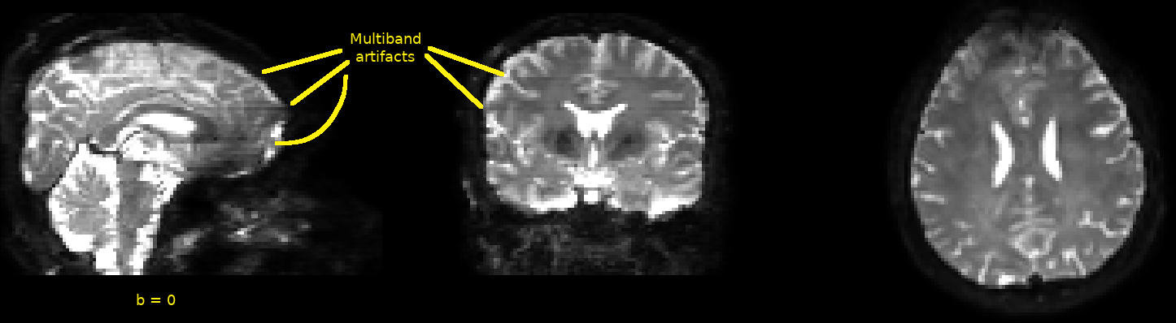
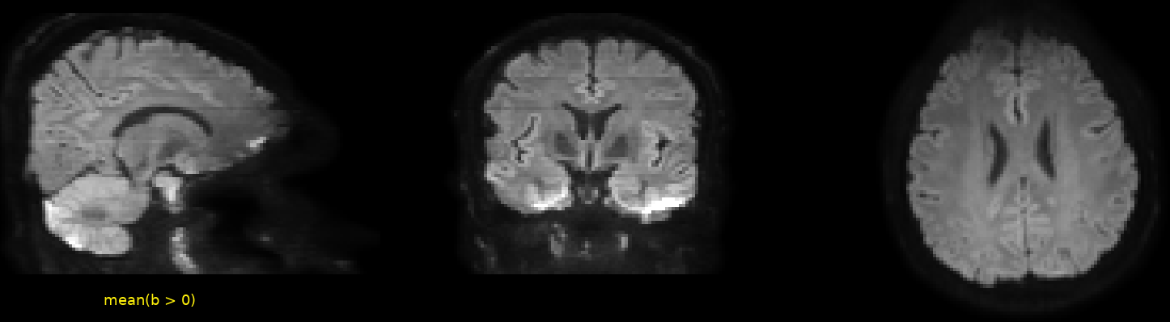
Multiband Artifacts with Philips 4x Slice Acceleration

Slide 3
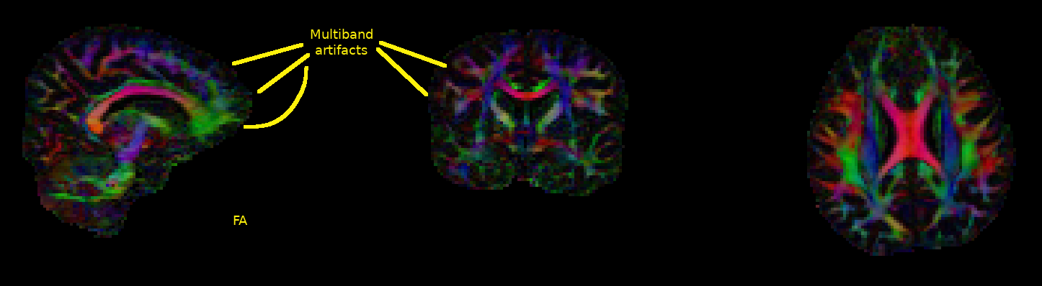
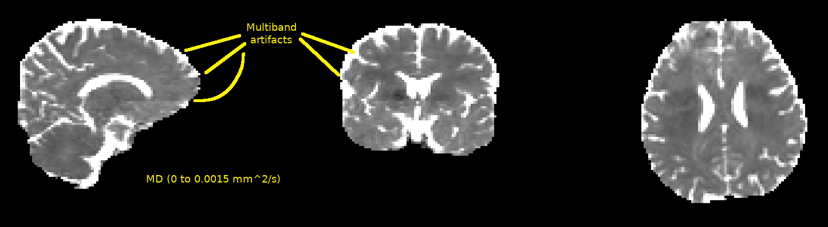
Multiband Artifacts with Philips 4x Slice Acceleration
The MB artifacts are much less conspicuous in FA and MD, esp. MD.

Slide 4
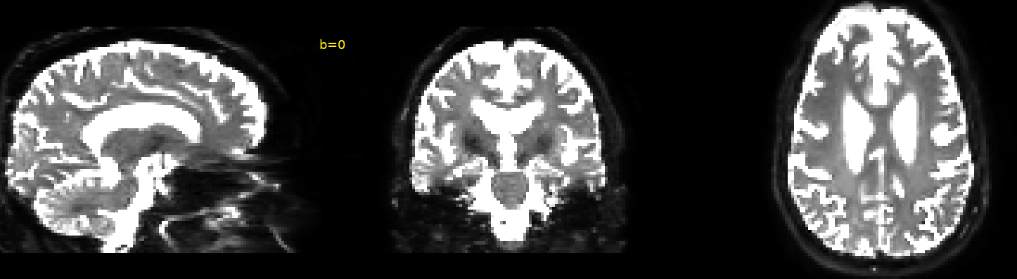
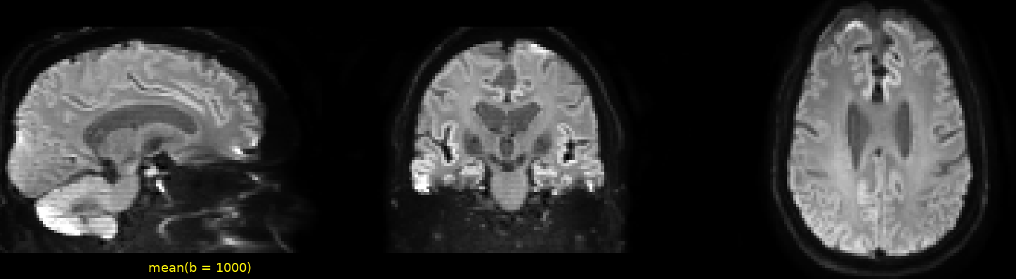
Comparison with Philips Basic
(Site 130, 70 cm bore, 5.6.1 software)

Slide 5
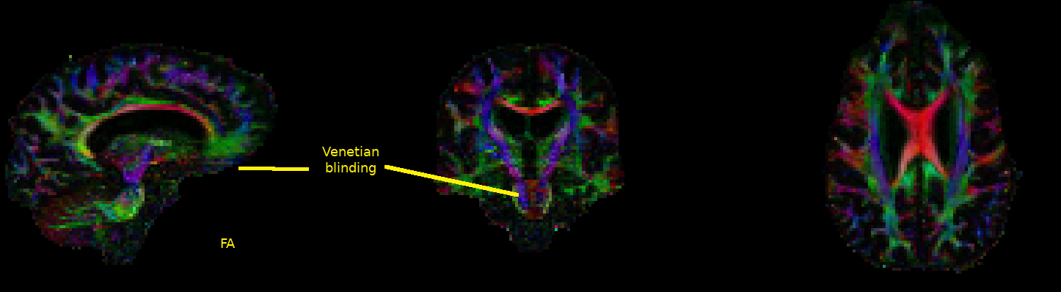
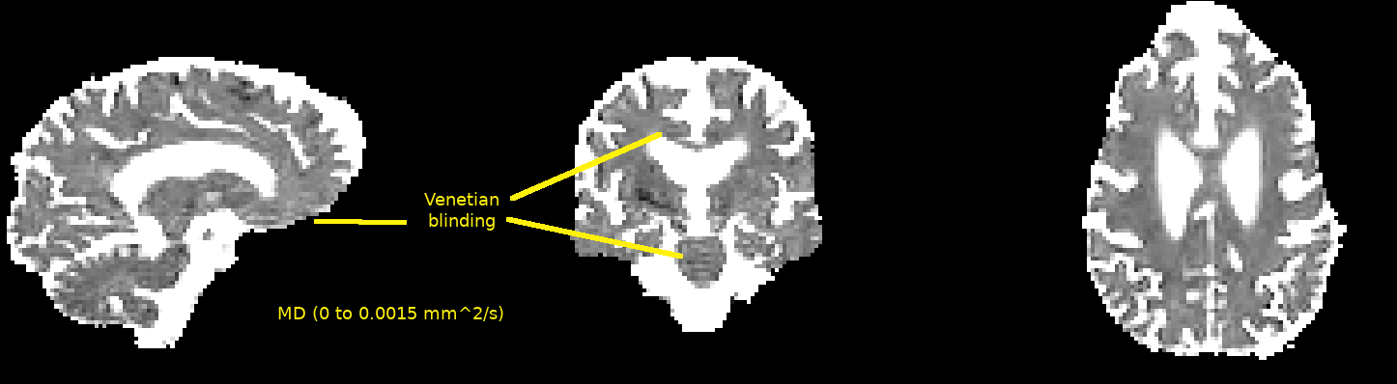
Comparison with Philips Basic
(Site 130, 70 cm bore, 5.6.1 software)
Venetian blinding does show up in FA and MD.

Slide 6
Philips dMRI Options (in no particular order)
Accept the MB artifacts as no worse than Venetian blinding
  Venetian blinding is reduced with MB because the time per volume is reduced
Stick with Philips Basic for the rest of ADNI3
Make a custom diffusion gradient set for ADNI3 Adv. Philips
  ADNI3’s Basic Philips is only getting 34-36 volumes anyway
  Keeping the Philips Basic b=1000 shell for longitudinal consistency would give us something like 8 b=0 + 6 b=500 + 32 b=1000 + 40 b=2000 = 86 volumes
    => ample time to use 3x slice acceleration (+ likely 2x phase acceleration)
      Whether that would remove the MB artifacts has not been tested.
      FWIW, 45 b=2000 volumes would (technically) allow 8th order spherical harmonics to be used for tractography.

Slide 7
Philips Advanced functional MRI for ADNI 3
The Siemens advanced protocol has a multi-band factor of 8 with TRs on the order of 600-720 ms depending on whether we are using a wide-bore or standard-bore scanner.
The basic fMRI protocol has TRs on the order of 3 seconds.
The following slides show an advanced Philips protocol for fMRI with different MB factors in order to try and match TRs on the order of 700ms on a Philips wide-bore scanner.

Slide 8
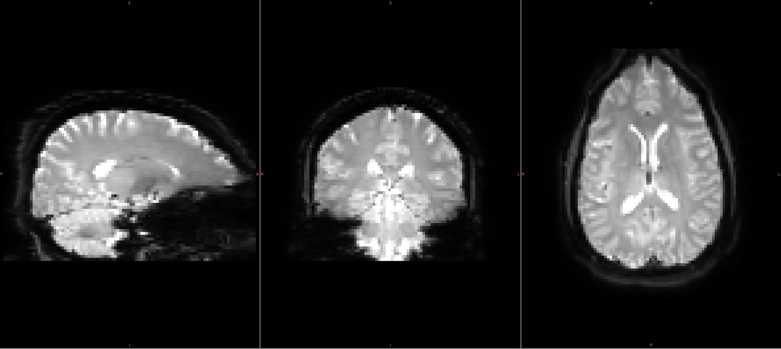
Potential Philips Advanced fMRI protocols
MB = 3, TR = 1.4 seconds

Slide 9
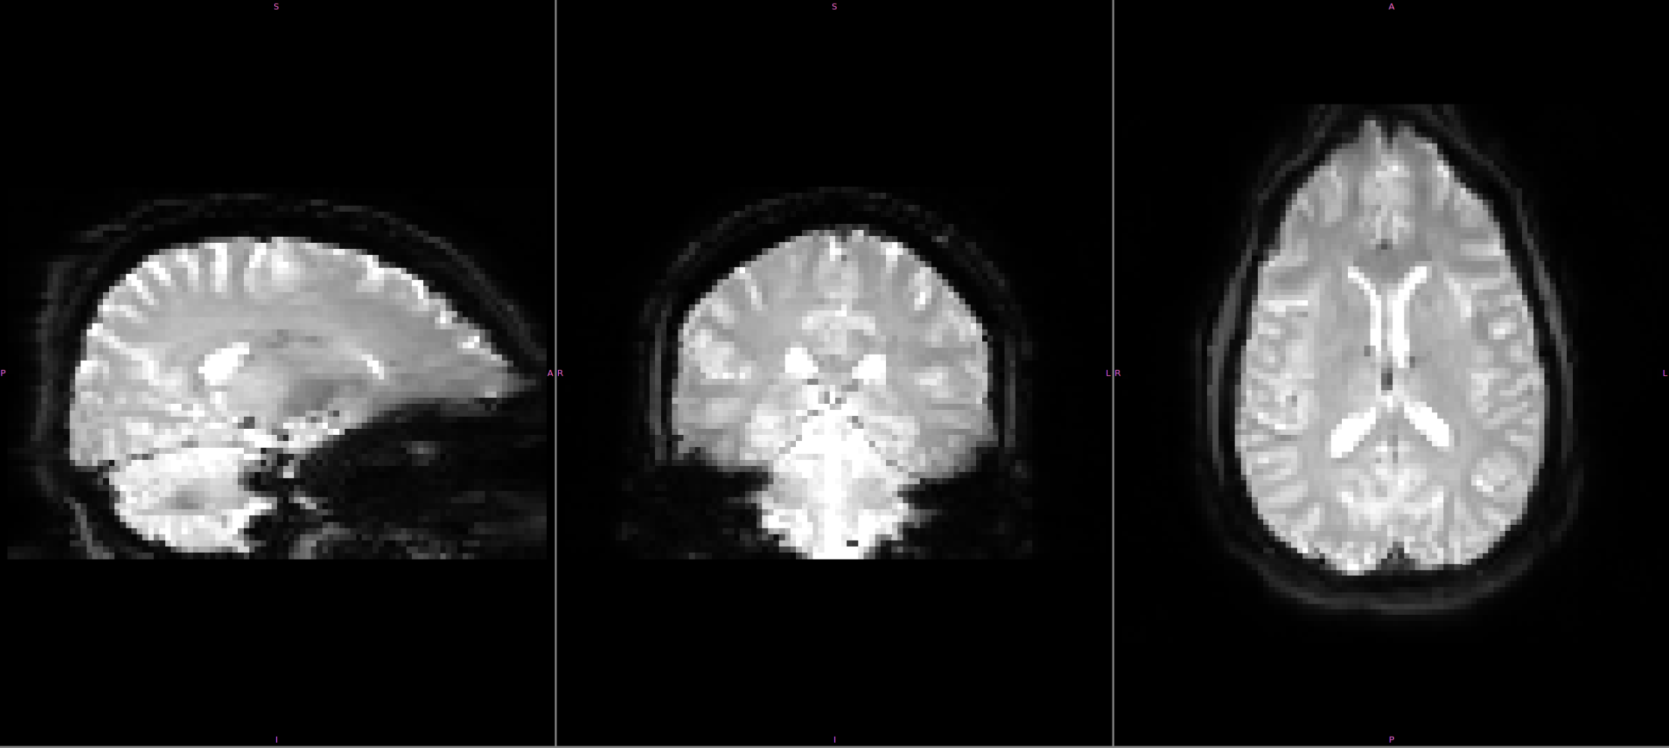
Potential Philips Advanced fMRI protocols
MB = 4, TR = 1.3 seconds
MB Artifact

Slide 10

Potential Philips Advanced fMRI protocols
MB = 5, TR = 1 second
MB Artifacts

Slide 11
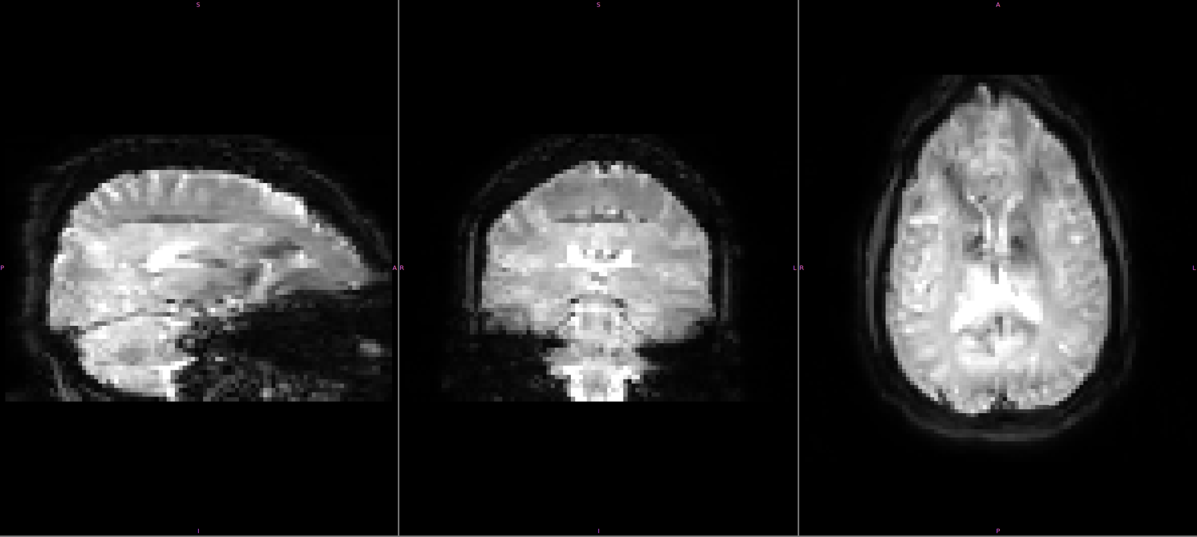
Potential Philips Advanced fMRI protocols
MB = 6, TR = 0.81 seconds
MB Artifacts

Slide 12
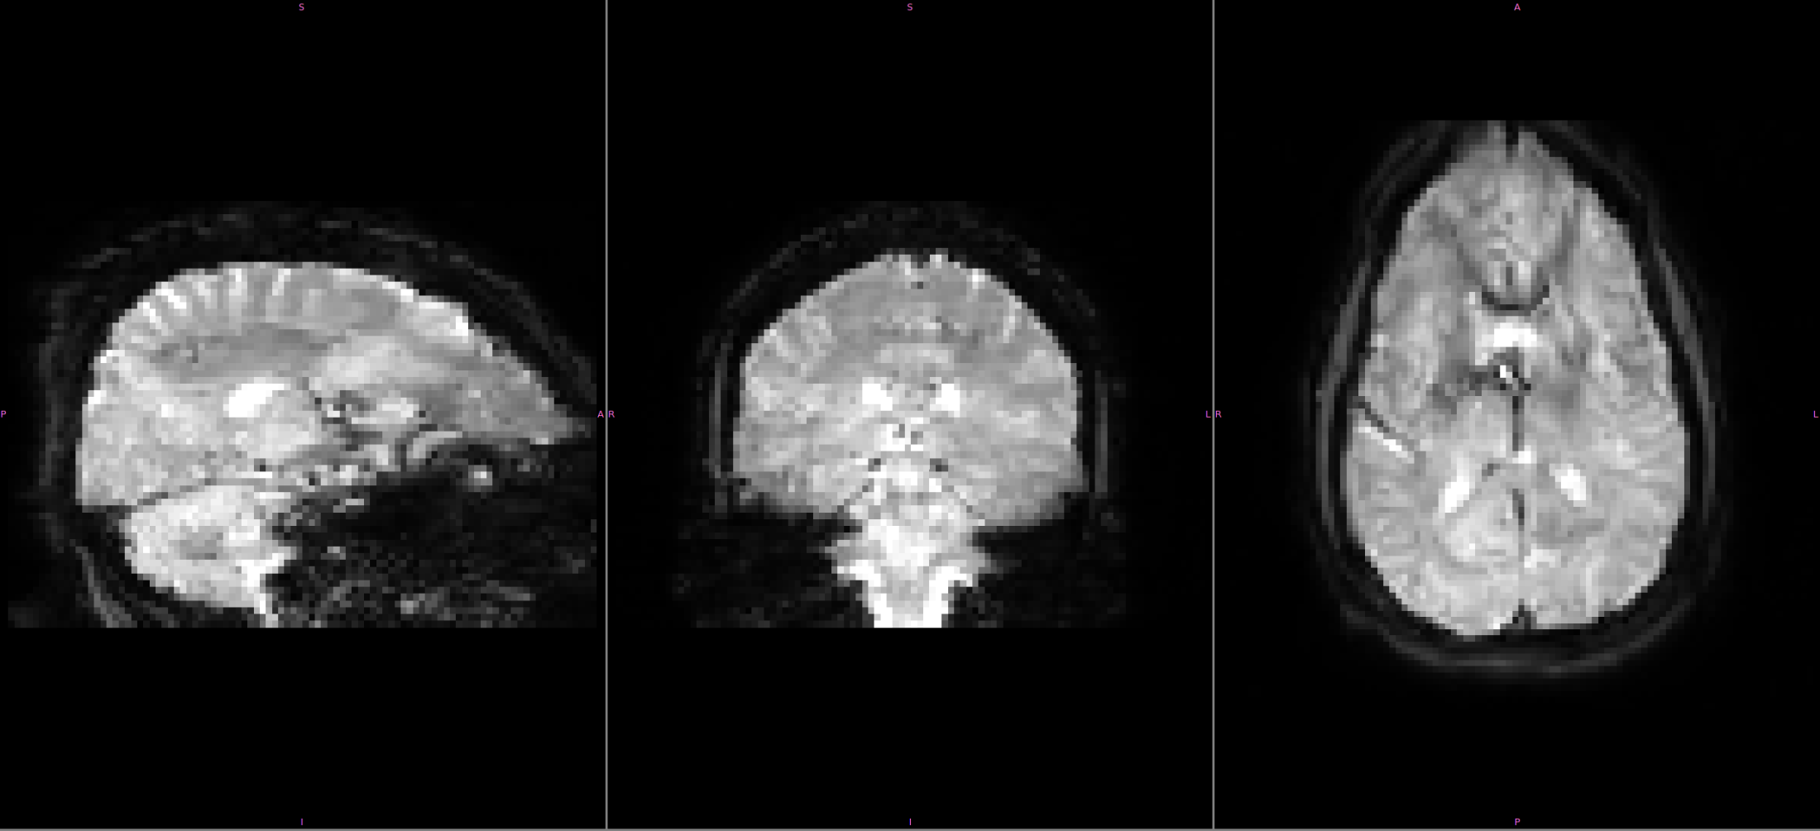
Potential Philips Advanced fMRI protocols
MB = 7, TR = 0.72 seconds
MB Artifacts

Slide 13
Future Directions
We can:
  Use the basic fMRI protocol on Philips to maintain continuity.
  Use a distorted MB 7 acquisition to try and maintain a 720 ms TR to match Siemens wide-bore scanners.
  Use a lower MB (3 or 4) acceleration and get a TR ~ 1.5 seconds and be halfway between the two protocols.

