Slide 1
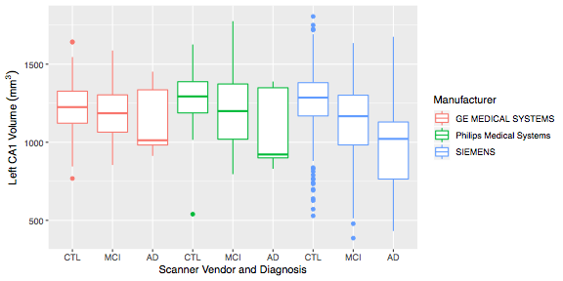
Hippocampal T2:Combining across scanner vendor and models within ADNI3 for cross-sectional analysis is OK
Age, ICV, DX are significant predictors of volume,
scanner vendor or model isn’t
Notes:
The first thing we looked at is if scanner vendor and models affect cross-sectional volumetric measurements in ADNI3, as this likely the most common type of analysis ADNI users will conduct. The conclusion remains the same as last year, with more data used. What’s plotted are the volumes of the left CA1 subfield, grouped by vendor and diagnosis. Age, ICV and diagnosis are strong predictors of volume, vendor is a weak predictor, but not predictive within controls. Model, Coil, and Software version aren’t significant predictors.

Slide 2
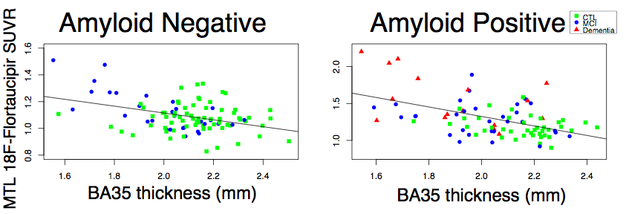
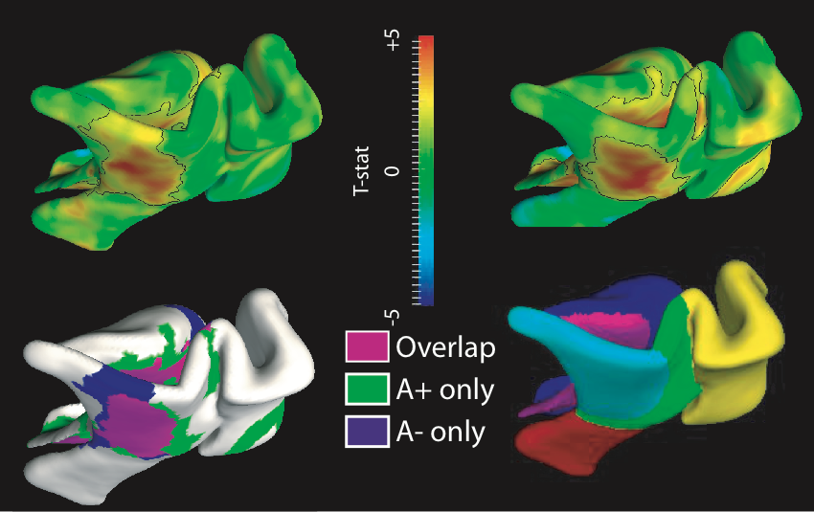
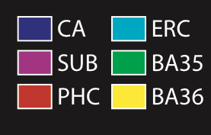
MTL subregional atrophy correlations with tau: spatial pattern
mimics early Braak stages in both amyloid positive and negative
Notes:
A summary measure of MTL cortex tau tracer uptake correlates with subregional atrophy. The spatial correlation pattern resembles early Braak stages. BA35 (perirhinal cortex)/ERC and CA1 subfield within hippocampus show the strongest effects. In regional thickness analysis (3d rendering of significance map of correlation), there is remarkable overlap (pink) in amyloid negative and positive patients.

Slide 3
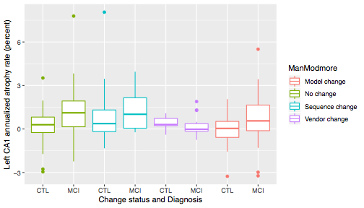
Hippocampal T2: Longitudinal subfield analysis using
deformation-based morphometry:
Mixing data when scanner or vendor changes for a subject not recommended
Technical Change
Diagnosis and age significant predictor of atrophy rate (higher is worse),
scanner change status also a predictor
Notes:
Next we looked at longitudinal measurements using deformation-based morphometry. Last year we looked at using ADNI2 data only (no change), which was OK. Here we use both ADNI2 and ADNI3 data. DX, age and technical change status are all significant predictors.

