Slide 1
ADNI3 FreeSurfer
UCSF
April 2019

Slide 2
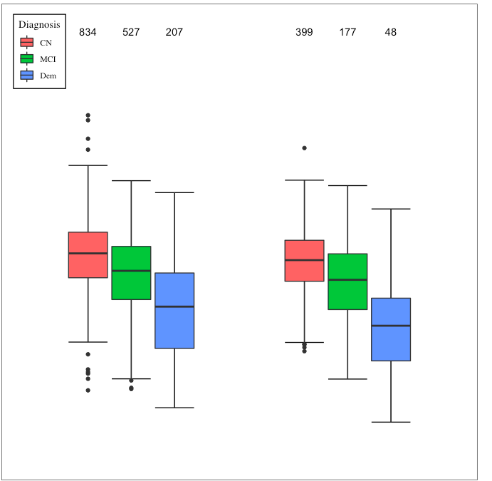
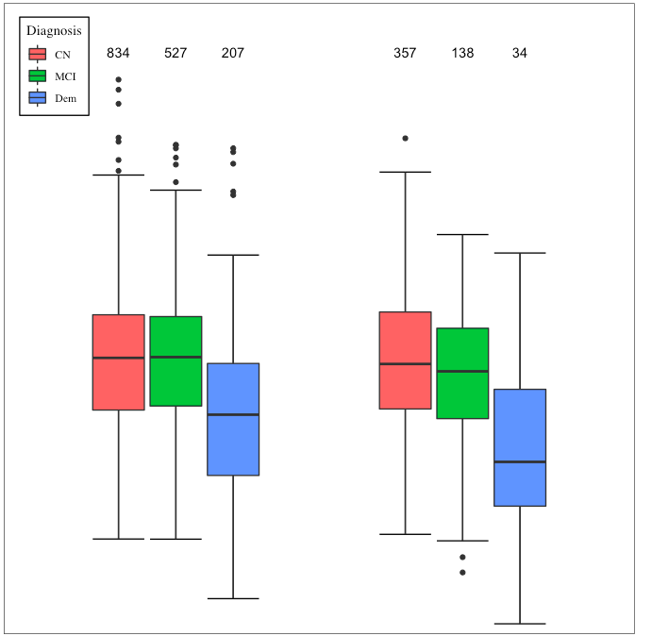
Hippocampal Volume
AD meta-ROI Volume
ADNI2 (FreeSurfer v5.1)
ADNI3 (FreeSurfer v6.0)
ADNI2 (FreeSurfer v5.1)
ADNI3 (FreeSurfer v6.0)

